Slide 1

Incorporating user experience practices into data-driven development of a biomedical software tool
Dave Miller
National Cancer Institute
Division of Cancer Biology
[Modeling, visualization, interactive media]
David.miller3@nih.gov
www.cancer.gov
Notes:
Hello, I’m David Miller. I’m an program director at the national cancer institute, one of the 27 institutes and centers that make up the NIH.
I manage a portfolio of extramural research grants in mathematical modeling & computational methods, and over the years I’ve been involved in a number of software & technology development programs both at NCI and across NIH. Today I’m briefly highlighting how the NCI has approached encouraging UX design practices in the development of biomedical software …
I should clarify that UX at the NCI is much broader than the extramural research software I’ll touch on here,… for instance there are a number of teams internally at the NCI who work on UX and usability of NCI software, websites, and various internal and externally facing tools.

Slide 2
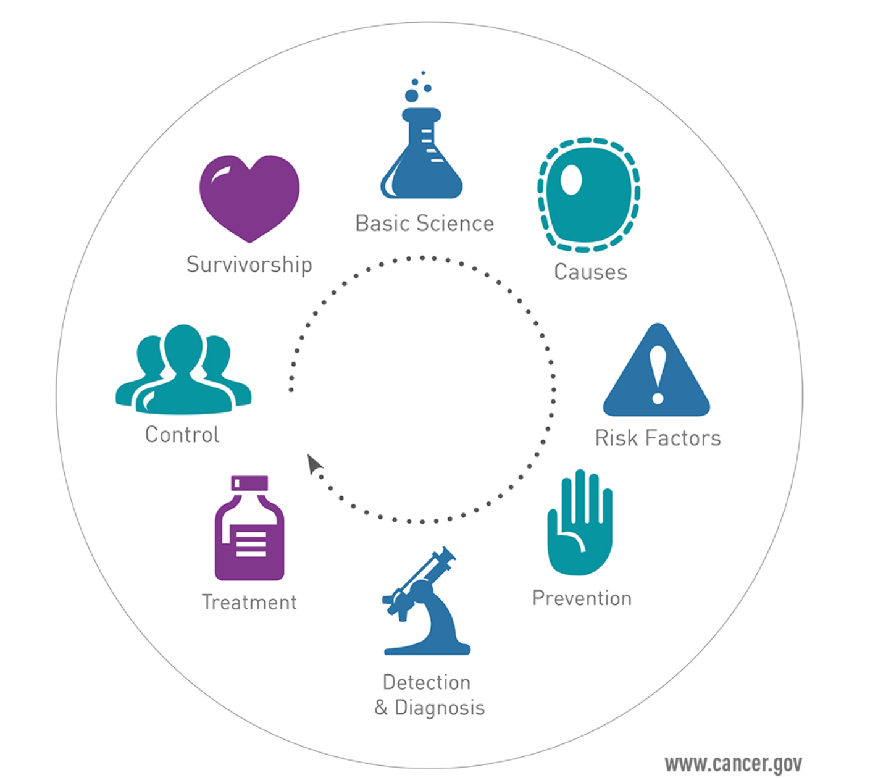
NCI Research
Notes:
Now, the NCI supports research grants that cover nearly all aspects of Cancer research, from basic science and biology research, to
Clinical research on diagnosis & treatments and on up through population-level studies and how to support patient & family emotional needs.
Now, a key to all of these areas are software tools, computational methods, and technologies that enable the research.
---

Slide 3
Methods & Software Tools for…
Data Management
Data & Metadata QA
Data Analysis
Data Wrangling
Data Integration
Data Compression
Data Visualization
Data Sharing
Data Provenance
Education & Training
Online Collaboration
Team Building
Simulation & Modeling
Workflows & Tool Chains
Virtual Environments
Crowdsourcing Methods
Navigating Large Search Spaces
Interacting with Complex Systems
Notes:
This is a slide use when I’m talking to the game developers, but the point remains the same that many, if not all, of the data management and methods development challenges that exist for general software development also exist for biomedical research.
The technologies and expertise needed to address software development, data management, project management and collaboration are all relevant toward addressing biomedical research challenges.
Now, I am a huge advocate for multi disciplinary research…. for practitioners to reach across aisles, bringing their expertise to biomedical research and likewise for biomedical researchers to recruit in expertise from other fields including UX, user centered design, data visualization, and game development.
---

Slide 4

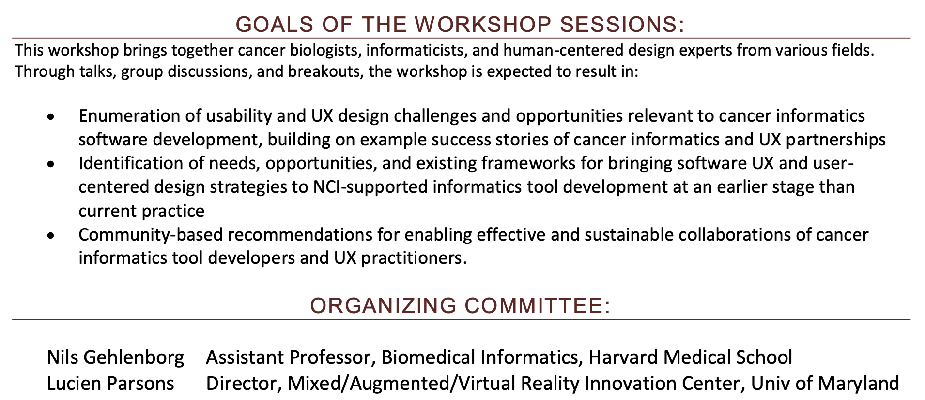
UX workshop
Notes:
Interestingly also at an educational technologies expo run by the department of education, I had a series of conversations discussing how much of the software development supported by the NCI did not at the time incorporate user centered design or UX approaches in their software development plan. Result of this was that sometimes not always but sometimes tools that were highly fit for purpose were not as well suited to the target audience of users as the researchers intended. My division at the national cancer institute was able to support a two day workshop a few years ago to explore the UX design challenges and opportunities relevant to cancer informatics software development, how to bring in such expertise earlier into the development lifecycle of NCI supportive tools, as well as how to encourage sustainable collaborations between tall developers and UX practitioners.
---

Slide 5
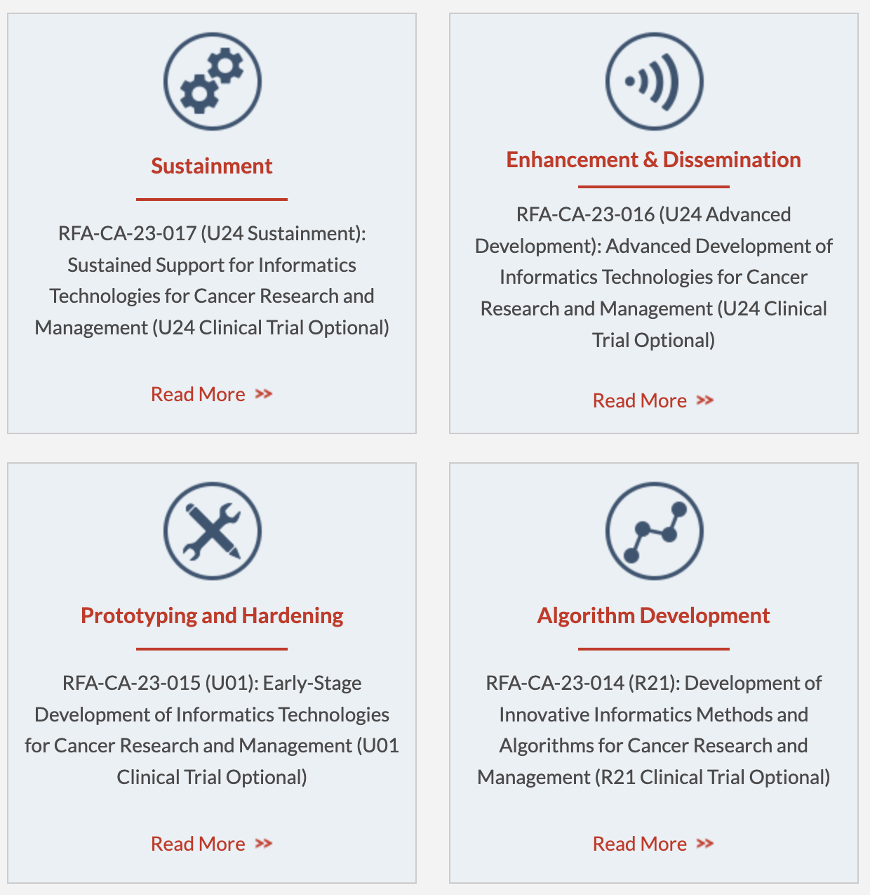
NCI Informatics Tools for Cancer Research
itcr.cancer.gov
Notes:
An important internal outcome from the 2019 workshop was adjustment in the language used in NCI funding opportunities, specifically those in the NCI’s “informatics tools for cancer research” program. These funding opportunities fund the development of cancer research software across the full development lifecycle – from simple algorithms to large software tools. The language in these funding announcements now include expectations for applicants to address the user experience design of the software tools and the developers plans for obtaining targeted user feedback during tool development.
Another way to put this is that the NCI does not dictate how research grant applicants should develop their proposed software tools (that’s up the researchers), however this NCI program does require applicants to describe their plan for developing software tools that people will actually want to use, and be able to use effectively.
---

Slide 6

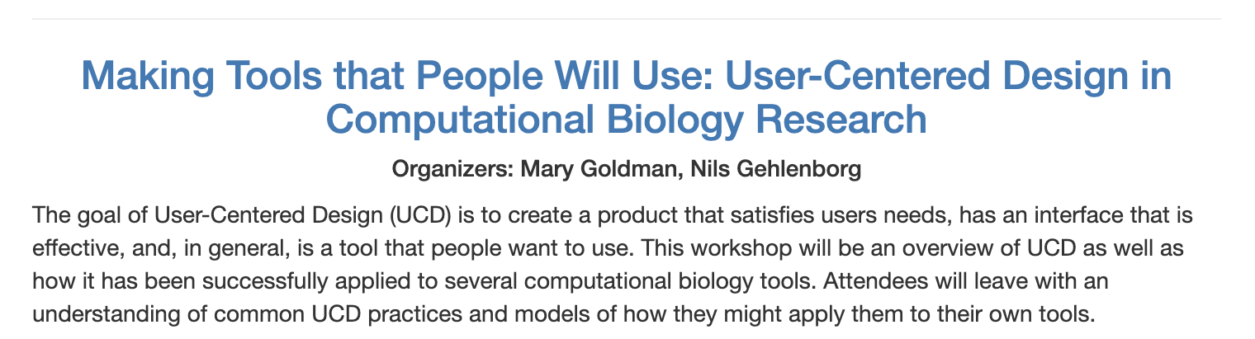

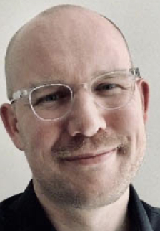
PSB workshop
Notes:
Another outcome that I was delighted to see was that Mary and Nils, both at that workshop, went on to organize a session at the Pacific Biocomputing conference a couple years ago with more hands on advice and examples for practitioners in employing user centered design principles in computational biology research and software tool development.
---

Slide 7
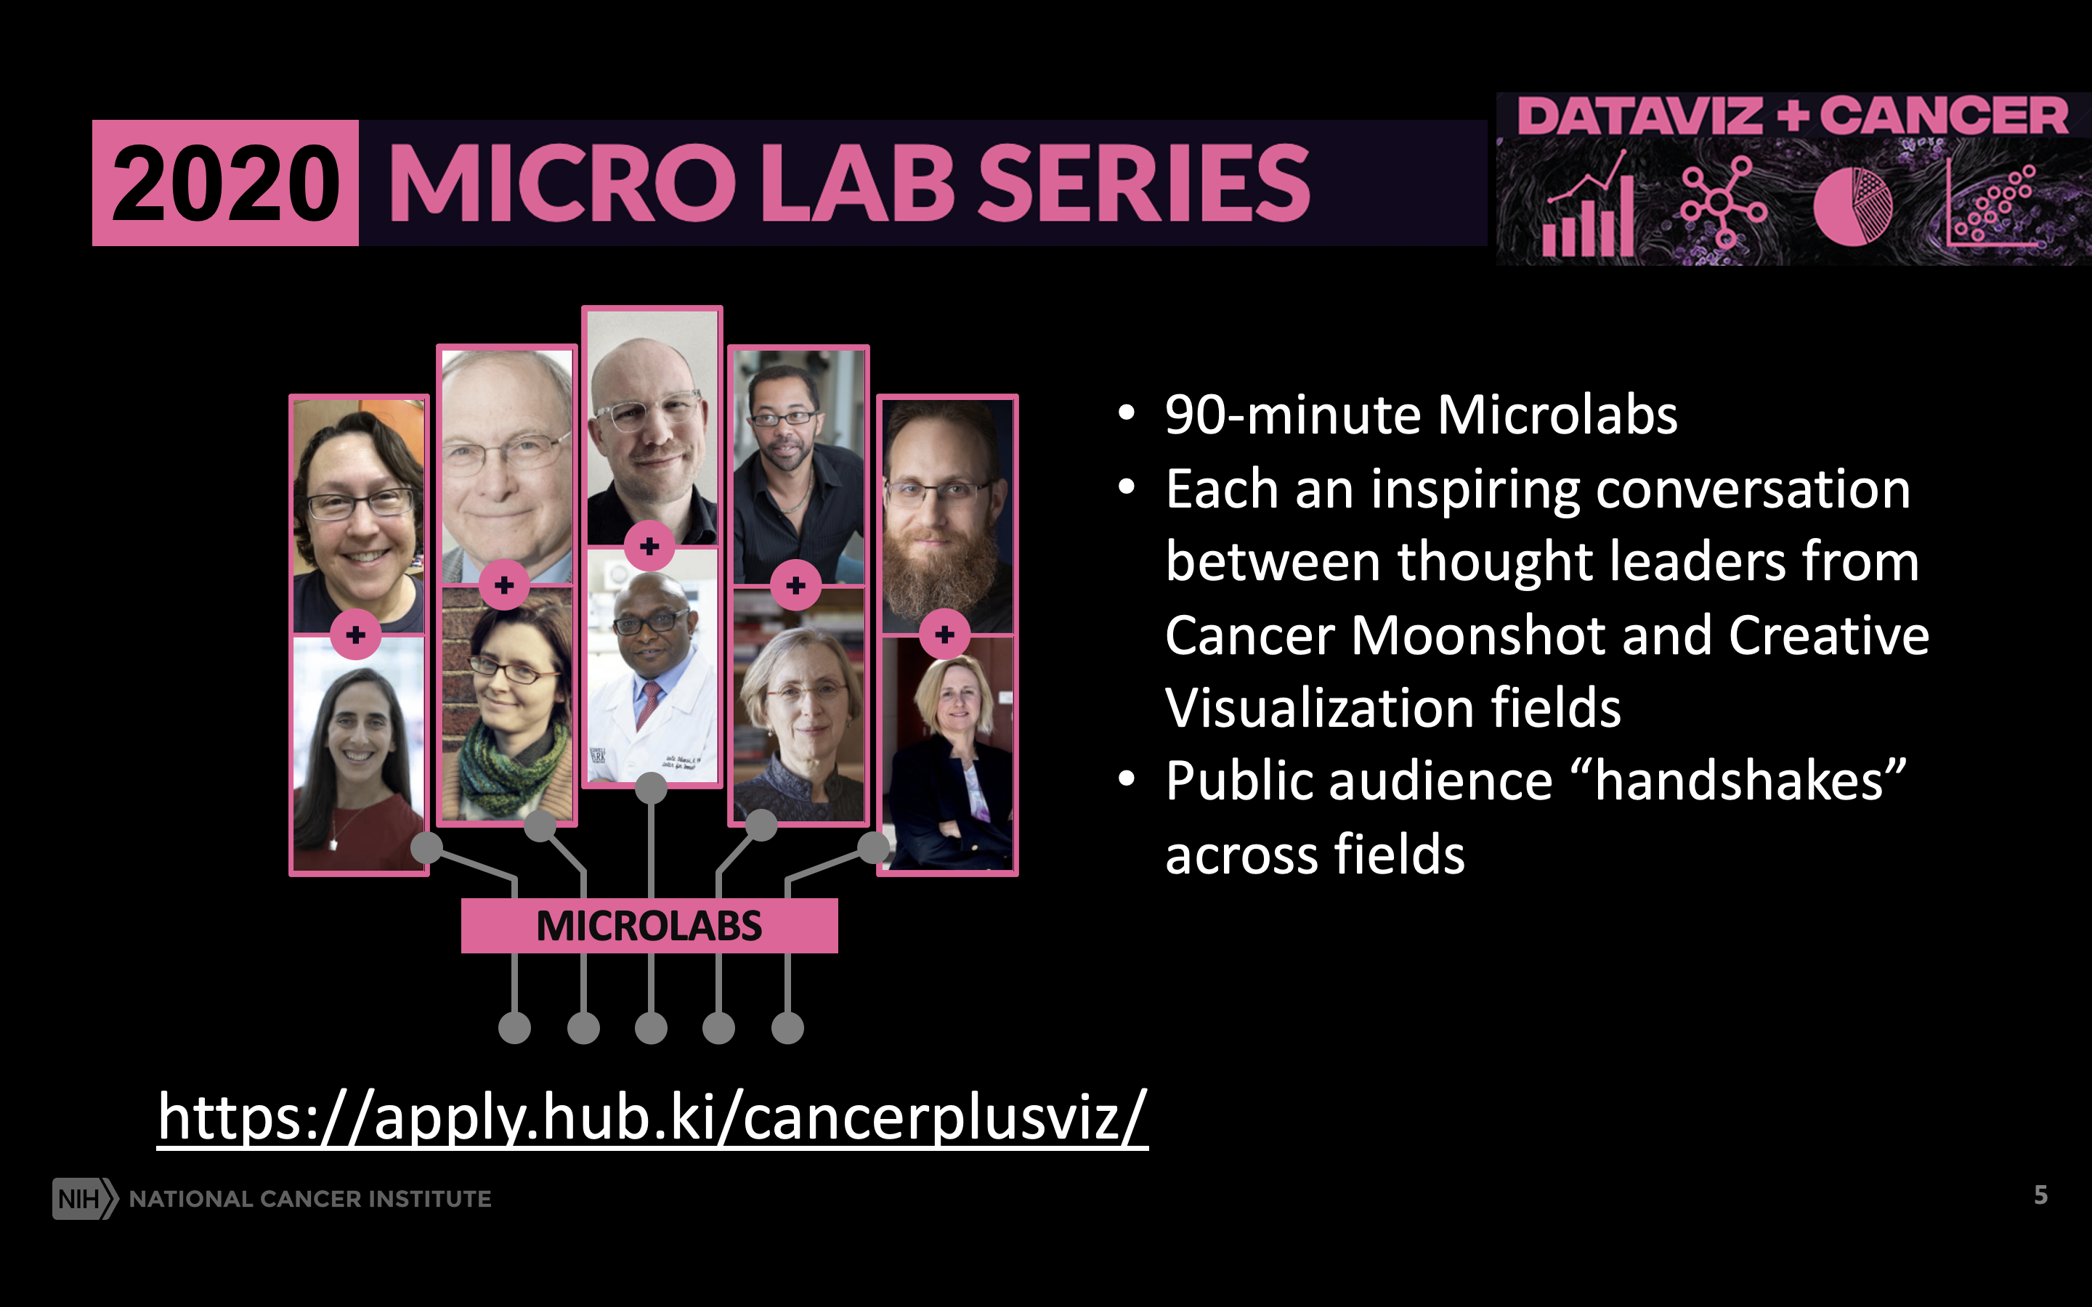
2020 Dataviz+cancer microlabs
Notes:
Now back to this crossover of expertise…,
Over the past three years I’ve been fortunate to have the NCI Cancer Moonshot support a research grants and a series of interactive events whose purpose is to highlight exciting areas that intersect these fields, and that demonstrate (via public participation) that anyone with an interest can bring their expertise to cancer research. This slide has the set of virtual microlabs we ran in 2020 that served as inspiring conversations between cancer researchers and experts from visual arts, game development, virtual reality, and user experience design. Each of these and the series we ran more recently can be viewed at the DataViz+Cancer website.
---

Slide 8
Mary Goldman University of California Santa Cruz Genomics Institute

Slide 9
Working in a research environment
UCSC Xena

Slide 10
UCSC Xena is a web-based visualization and analysis tool for large-scale cancer genomics data

Slide 11
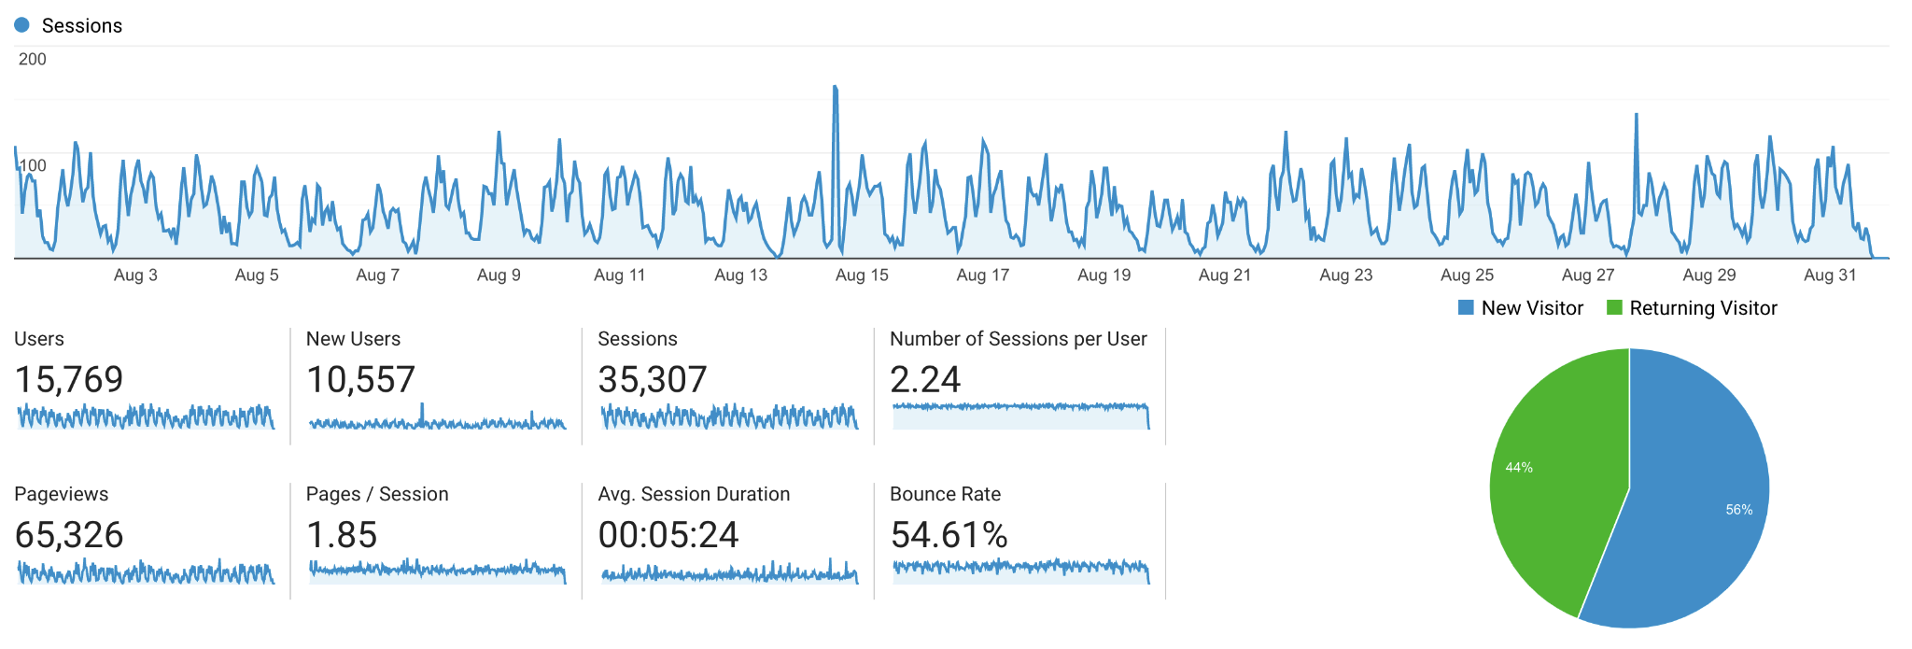
UCSC Xena Usage August 2022
Monthly stats:
15K users over 35K sessions
88 countries
Notes:
increasing

Slide 12
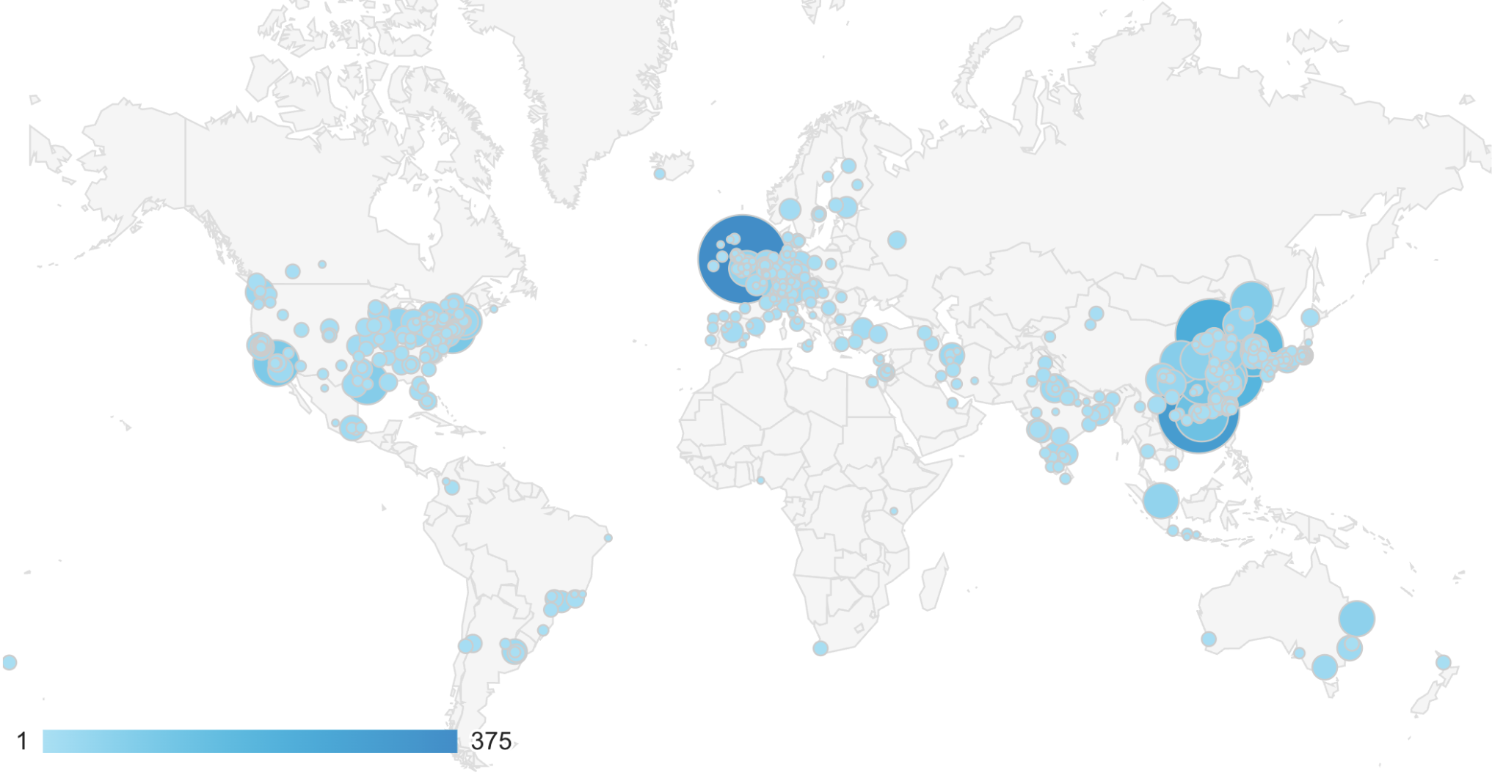
UCSC Xena Usage August 2022 (cont’d)
Users
Notes:
increasing

Slide 13
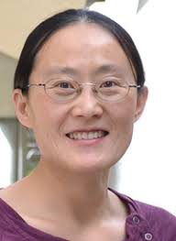
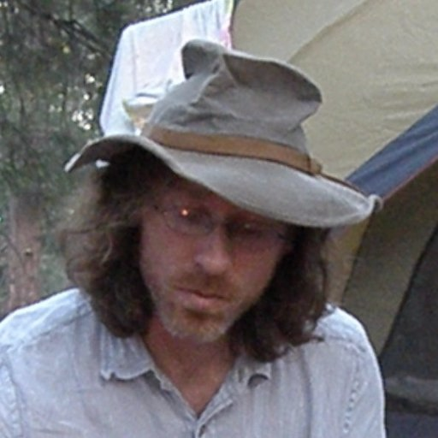

Core team for UCSC Xena
Jing Zhu
Brian Craft
Mary Goldman
Principal Investigator,
AKA. the boss
Also does data curation and management
Software Developer
Backend + frontend
Design and Outreach Engineer
UX design
Social Media outreach
Create and teach workshops
Create help docs/videos
Help write grants/reports
QA testing new data/code
Email/forum help support

Slide 14

Research is fast-paced
Scientific collaborations move quickly
New features/apps need to be available rapidly
More and more data is coming out all the time
New data types from new experiments
'It takes all the running you can do, to keep in the same place'
Notes:
This cover has been designed using images from Flaticon.com

Slide 15
So why do UX in a research environment?

Slide 16
UX is worth the effort
Small efforts are worthwhile
Tool that addresses user needs
A more user-friendly site
Something is better than nothing
Great design takes a lot of creativity, time, and energy. Pretty good design is much easier

Slide 17
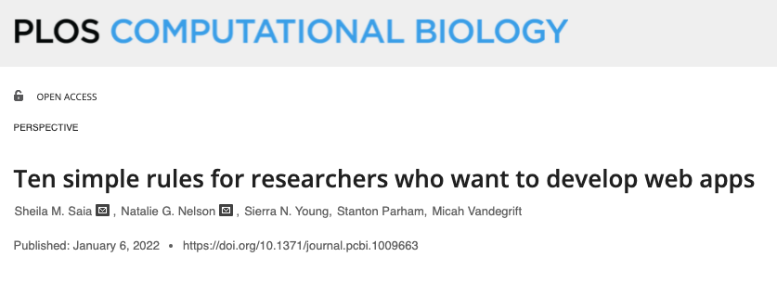
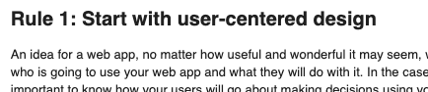
The community agrees …
https://journals.plos.org/ploscompbiol/article?id=10.1371/journal.pcbi.1009663

Slide 18
UX in a research environment:
Power of prototyping

Slide 19
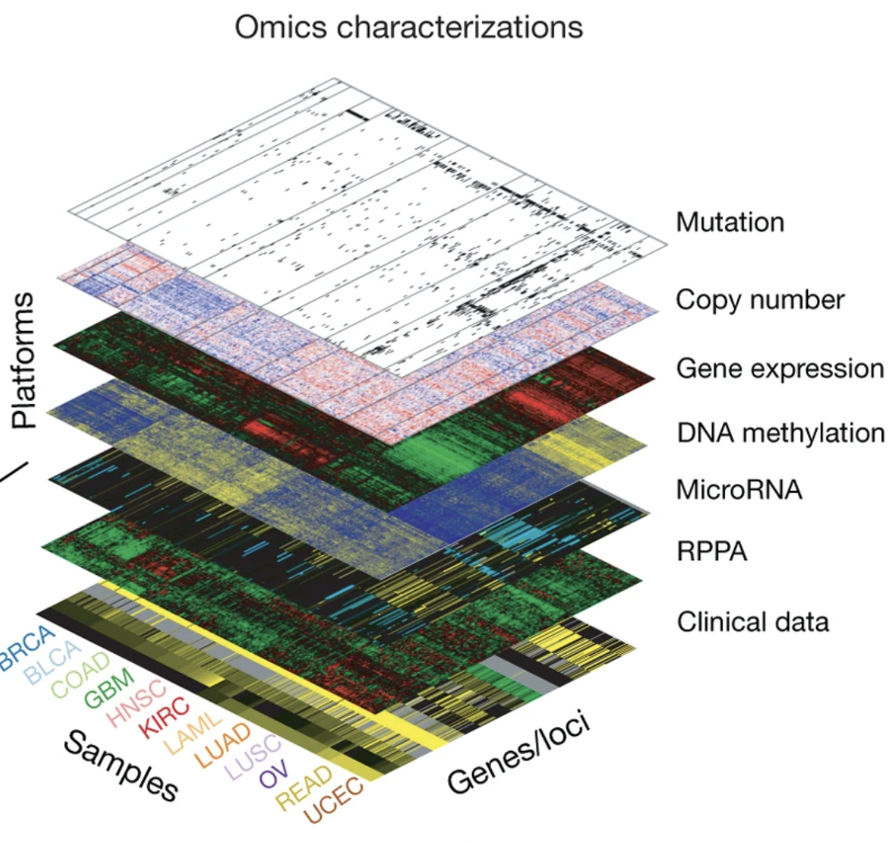
Research data is complex
How do you visualize complex data?
How do you create a tool to create that visualization?
How do you communicate to the user what the visualization is? And how to manipulate it?
Part of Figure 1 from
The Cancer Genome Atlas Program (TCGA) Network, et al. 2013
Notes:
https://www.nature.com/articles/ng.2764

Slide 20
Visualizing complex data
Get inspired!
Data visualization conferences
Scientific papers
Analogies/common experiences
Talk to your users
Every interaction is an opportunity!

Slide 21

How to talk to your users
Don't pitch an idea
No leading questions
Favorite tools and why
Background, skill set, and environment
Questions that drive their research
Notes:
This cover has been designed using images from Flaticon.com

Slide 22

Next step: prototype
Create more than one. Ideally a lot!
Create early in the design process
Prototypes allow you to get user feedback early in the design process
Notes:
This cover has been designed using images from Flaticon.com

Slide 23
How to create prototypes
But I'm not an artist!
Make quick sketches on paper and pencil

Slide 24
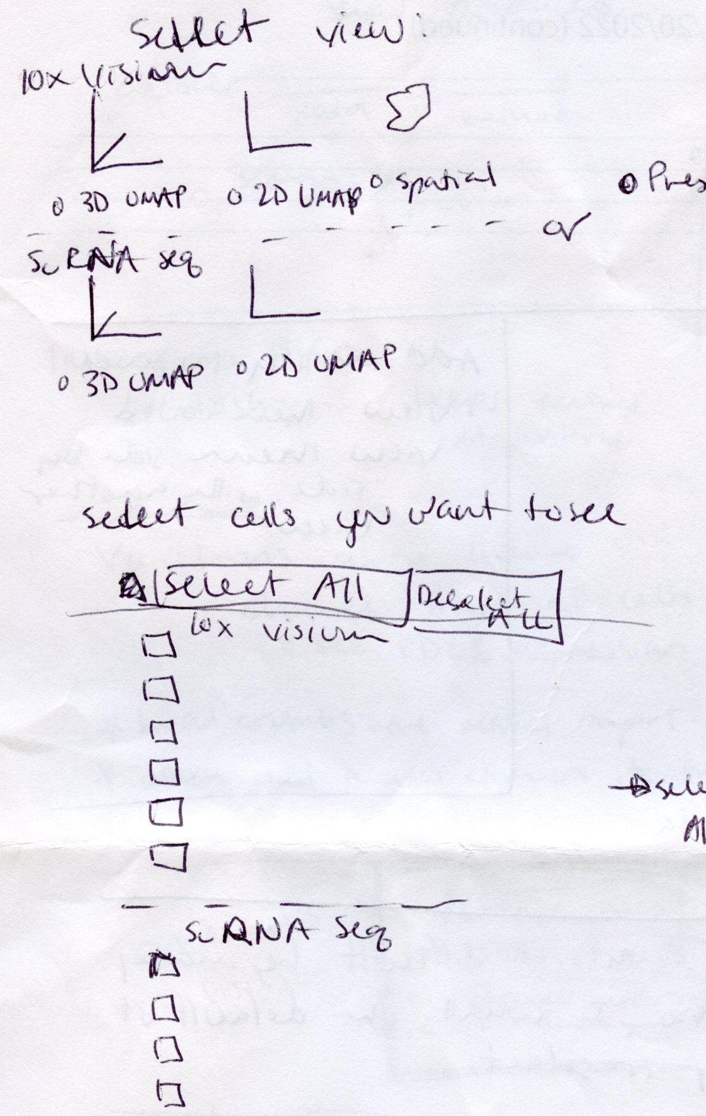
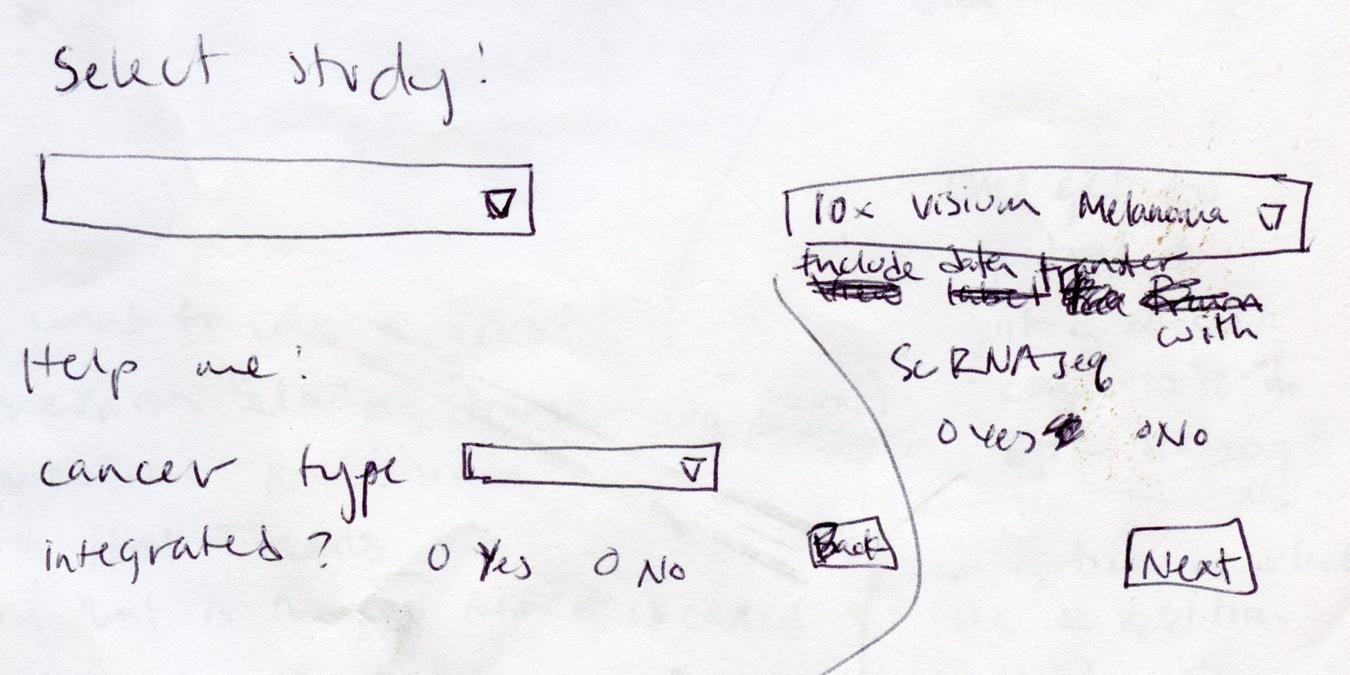
But I'm not an artist!
Neither am I!

Slide 25
Example from Xena: Chart View
Came up with 15 different design ideas
Internal team narrowed to 3 designs based on:
Best practices from other applications
How easy it would be to implement
→ Build prototypes to run by users

Slide 26
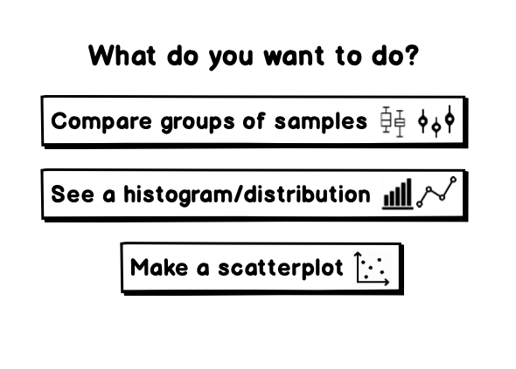
Build prototypes cheaply
Use slides or prototype building software
Create clickable PDFs or advance slides for user
More honest feedback if less real since it doesn't feel finished

Slide 27

User interviews
Recruited 3 users
1 hour interview with each
Gave a task and watch them use each of the new designs
Asked them to 'think aloud'
Notes:
This cover has been designed using images from Flaticon.com

Slide 28
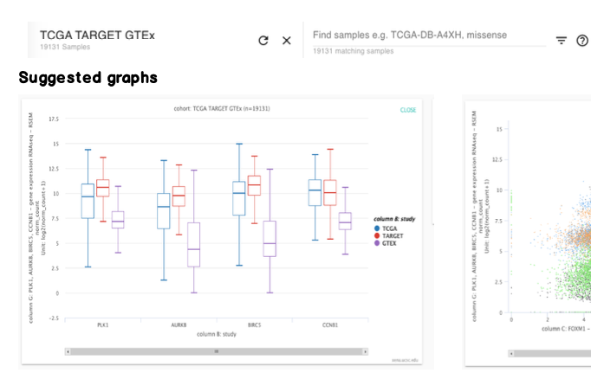
Results of user interviews
'Wizard' prototype
'Show all' prototype

Slide 29
Wizard Prototype Advantages
'Wizard' prototype
Users felt empowered to make the graphs they wanted
Users said it could make the most types of graphs (even though it had the same number as all the other prototypes!)
"What do you want to do?" There's that sense that you have control over what is being made. I like that you go through the process yourself.

Slide 30
Conclusions: prototyping
Get inspired
Make many of them
Make them cheaply
Show them to users if you can - you may be surprised!

Slide 31
UX in a research environment: Heuristic evaluation

Slide 32
What is heuristic evaluation
Evaluate an application or prototype by 10 'best practices'
Great for when the application is already up
Evaluation can be done by you, or really anyone who regularly uses the web

Slide 33
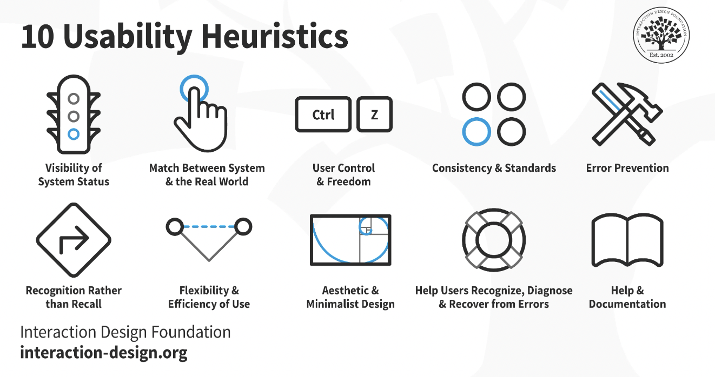
Ten 'Best Practices' Criteria
Notes:
10 usability heuristics from https://www.interaction-design.org/literature/topics/heuristic-evaluation

Slide 34
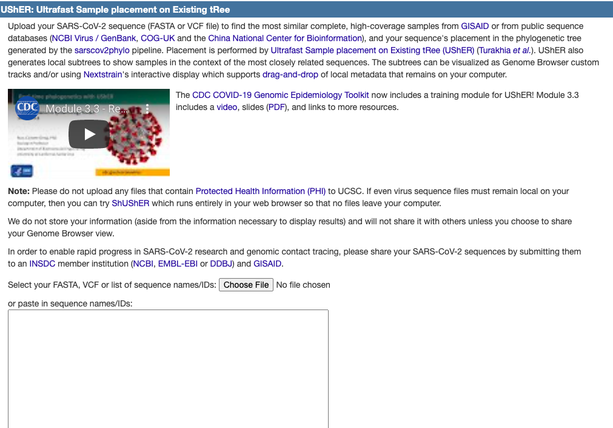
Old site for SARS-CoV-2 analysis tool UShER
8. Aesthetic and minimalistic design:
Very dense and wordy information about UShER.
4. Consistency and standards
Here is where we interact with the tool. From other well-used websites, I would expect this to be closer to the top

Slide 35
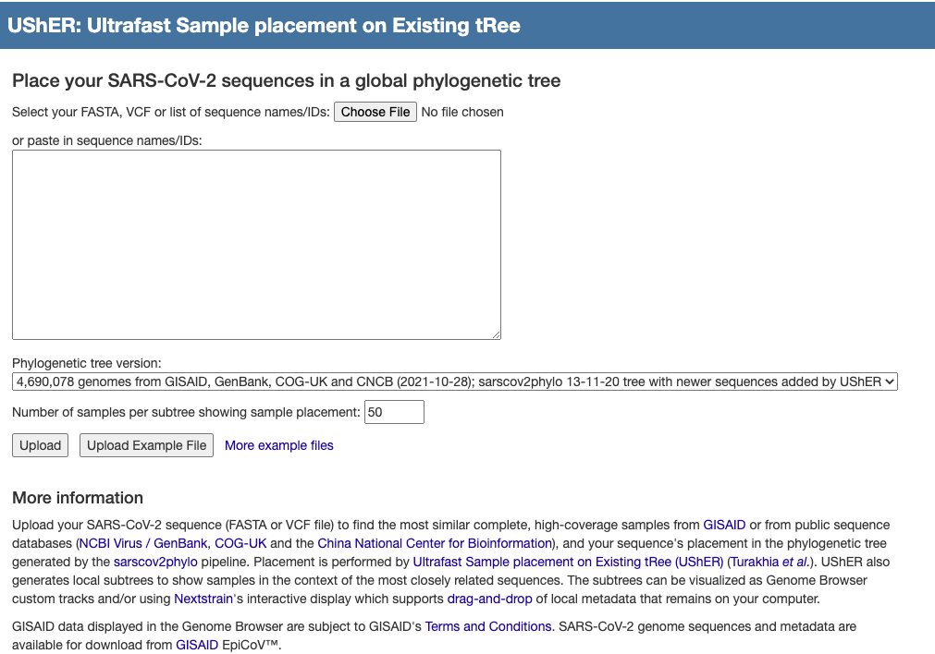
New site for SARS-CoV-2 analysis tool UShER
8. Aesthetic and minimalistic design:
Short description
4. Consistency and standards
Input box is at the top

Slide 36
Conclusions: heuristic evaluation
Quick way to make an application more user friendly, without expending a lot of resources
Added benefit of evangelizing UX
Heuristic Evaluation as a service

Slide 37
Conclusions: UX in a research environment
Despite limited time/energy, UX is worth it
Prototyping leads to more creative solutions
Talk to your users: they can surprise you
Heuristic evaluation can quickly improve usability

Slide 38

Thank you!
Questions?
mary@soe.ucsc.edu

